Slide 1


SRI RAMAKRISHNA ENGINEERING COLLEGE
[Educational Service : SNR Sons Charitable Trust]
[Autonomous Institution, Reaccredited by NAAC with ‘A+’ Grade]
[Approved by AICTE and Permanently Affiliated to Anna University, Chennai]
[ISO 9001:2015 Certified and all Eligible Programmes Accredited by NBA]
VATTAMALAIPALAYAM, N.G.G.O. COLONY POST, COIMBATORE – 641 022.
Department of Information Technology
20IT252 – Java Programming (TcL)
Presentation by
Dr.S.Vaishnavi
Assistant Professor (OG)/ IT

Slide 2
20IT252 – JAVA PROGRAMMING
Module III : COLLECTION FRAME WORK AND FUNCTIONAL PROGRAMMING 8
Introduction: Annotations -Auto boxing -Java Collection Framework: Vector - List -Tree Set -Hash Map - Enum - Stack - Queue - Deque - New Features: Lamda expressions - Functional Interfaces - Method References
JAVA PROGRAMMING - S.VAISHNAVI

Slide 3
Annotations
JAVA PROGRAMMING - S.VAISHNAVI

Slide 4
Java Annotations
Annotations are used to provide supplemental information about a program.
Annotations start with ‘@’.
Annotations do not change the action of a compiled program.
provide additional information to the compiler and JVM
tag representing metadata about classes, interfaces, variables, methods, or fields
Are different from comments since they can affect how the program is treated by the compiler
JAVA PROGRAMMING - S.VAISHNAVI

Slide 5
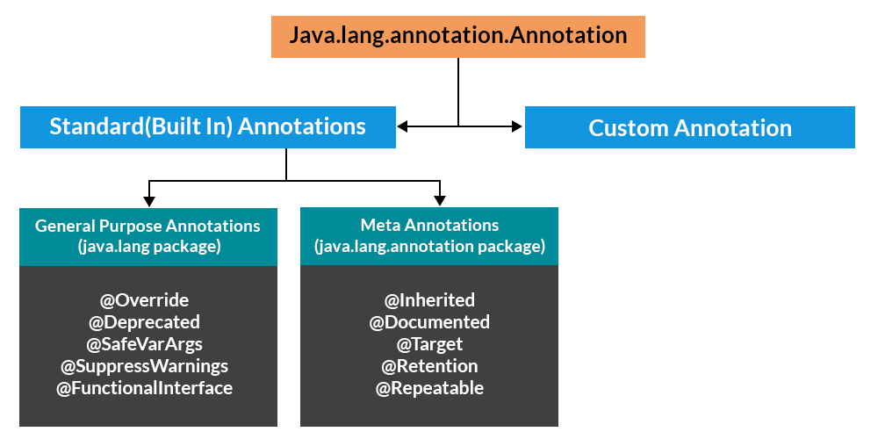

Slide 6
Categories of Annotations
There are broadly 5 categories of annotations as listed:
  Marker Annotations
  Single value Annotations
  Full Annotations
  Type Annotations
  Repeating Annotations
JAVA PROGRAMMING - S.VAISHNAVI

Slide 7
Marker Annotations
Marker annotations do not contain members/elements.
It is only used for marking a declaration.
Only the presence of a marker annotation as an annotation is sufficient.
Its syntax is:
E.g., @Override, @Test
@AnnotationName()
JAVA PROGRAMMING - S.VAISHNAVI

Slide 8
Single value Annotations
consists of a single member only
allow a shorthand form of specifying the value of the member.
Its syntax is:
@AnnotationName(elementName = "elementValue")
JAVA PROGRAMMING - S.VAISHNAVI

Slide 9
Full Annotations
These annotations consist of multiple data members, names, values, pairs.
Its syntax is:
@AnnotationName(element1 = "value1", element2 = "value2")
JAVA PROGRAMMING - S.VAISHNAVI

Slide 10
Type Annotations
These annotations can be applied to any place where a type is being used
E.g.
  annotate the return type of a method
These are declared annotated with @Target annotation.
JAVA PROGRAMMING - S.VAISHNAVI

Slide 11
Annotation placement
Above declarations
  Java annotations can be placed above class, method, interface, field, and other program element declarations
place annotations wherever we use a type
JAVA PROGRAMMING - S.VAISHNAVI

Slide 12
Auto boxing
JAVA PROGRAMMING - S.VAISHNAVI

Slide 13
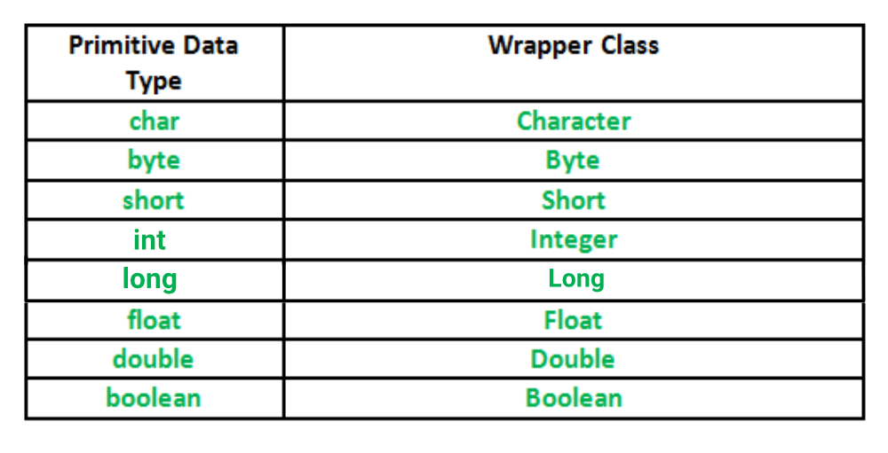
Wrapper Class
Primitive Data Types can be converted into object type by using wrapper class
in java.lang package
JAVA PROGRAMMING - S.VAISHNAVI

Slide 14
Autoboxing and Unboxing in Java
The automatic conversion of primitive data types into its equivalent Wrapper type is known as Autoboxing and opposite operation is known as unboxing.
Autoboxing has a great advantage while working with Java collections.
int a = 56; // autoboxing
Integer aObj = a;
JAVA PROGRAMMING - S.VAISHNAVI

Slide 15
Advantage of Autoboxing and Unboxing in Java
A Java programmer does not need to explicitly or manually write the code to convert primitive data to the wrapper class object and vice versa.
Java compiler automatically performs autoboxing and unboxing as and when needed
JAVA PROGRAMMING - S.VAISHNAVI

Slide 16
Java Collection Framework
JAVA PROGRAMMING - S.VAISHNAVI

Slide 17
Java Collections
Collection in Java is a framework that provides an architecture to store and manipulate the group of objects.
provides a set of interfaces and classes to implement various data structures and algorithms i.e operations that you perform on a data such as searching, sorting, insertion, manipulation, and deletion.
A Collection represents a single unit of objects, i.e., a group
Framework - readymade architecture, set of classes and interfaces.
JAVA PROGRAMMING - S.VAISHNAVI

Slide 18
Java Collection Framework
A Java collection framework provides an architecture to store and manipulate a group of objects. A Java collection framework includes the following:
  Interfaces
  Classes
  Algorithm
JAVA PROGRAMMING - S.VAISHNAVI

Slide 19
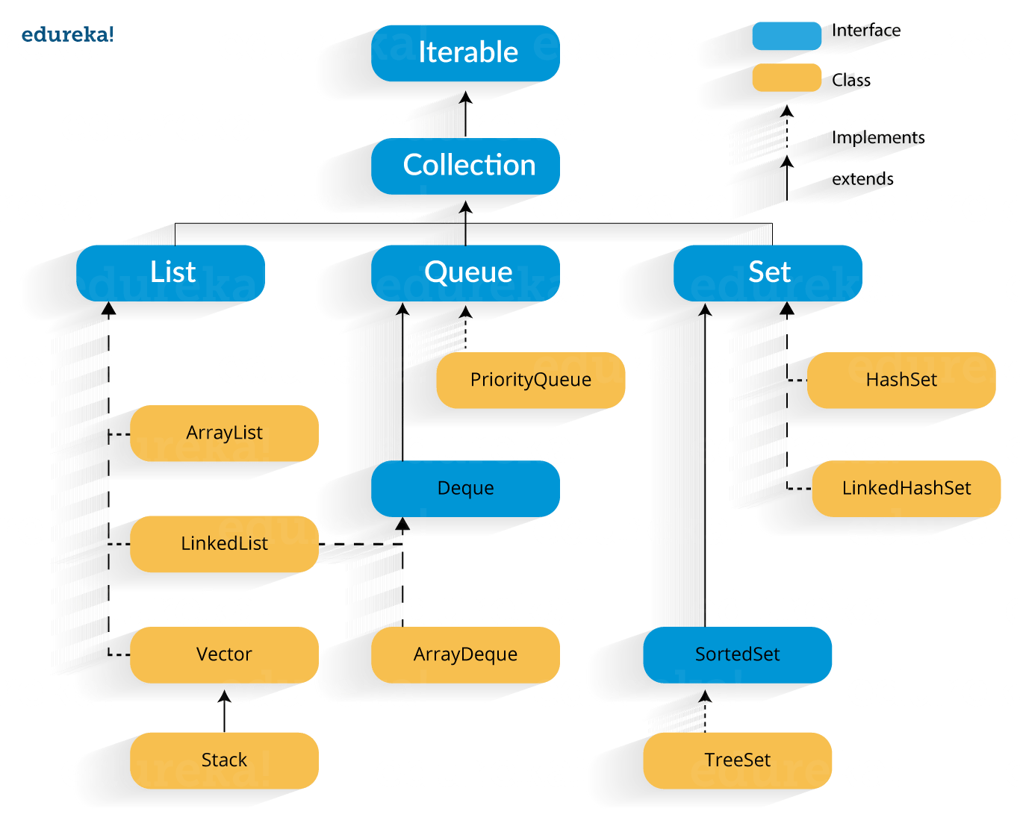

Slide 20
Why use Java collection?
Reducing the effort required to write the code by providing useful data structures and algorithms
Java collections provide high-performance and high-quality data structures and algorithms thereby increasing the speed and quality
Unrelated APIs can pass collection interfaces back and forth
Decreases extra effort required to learn, use, and design new API’s
Supports reusability of standard data structures and algorithms
JAVA PROGRAMMING - S.VAISHNAVI

Slide 21
Method | Description
add() | Add objects to collection.
isEmpty() | Returns true if collection is empty
clear() | Removes all elements from the collection
remove() | Remove a selected object
size() | Find the number of elements
stream() | Return Sequential elements
toArray() | Returns elements in array format
hashCode() | Returns Hashcode of the elements
equals(obj X) | Compare an element with the collection
iterator() | Return an iterator over collection
max() | Return max value in the collection
contains() | Returns true is a particular value is present
spliterator() | Creates splietarator over the elements in the collection
retainAll() | Retains elements in the collection
JAVA PROGRAMMING - S.VAISHNAVI

Slide 22
Vector
JAVA PROGRAMMING - S.VAISHNAVI

Slide 23
Vector
dynamic array which can grow or shrink its size
implements the List interface
Vector class synchronizes each individual operation.
  whenever we want to perform some operation on vectors, the Vector class automatically applies a lock to that operation.
when one thread is accessing a vector, and at the same time another thread tries to access it, an exception called ConcurrentModificationException is generated
JAVA PROGRAMMING - S.VAISHNAVI

Slide 24
Creating a Vector
Vector<Type> vector = new Vector<>();
Vector<Integer> vector = new Vector<>();
Vector<String> vector= new Vector<>();
JAVA PROGRAMMING - S.VAISHNAVI

Slide 25
Vector
Adding Elements
add(element) - adds an element to vectors
add(index, element) - adds an element to the specified position
addAll(vector) - adds all elements of a vector to another vector
Access Vector Elements
get(index) - returns an element specified by the index
iterator() - returns an iterator object to sequentially access vector elements
Remove Vector Elements
remove(index) - removes an element from specified position
removeAll() - removes all the elements
clear() - removes all elements. It is more efficient than removeAll()
JAVA PROGRAMMING - S.VAISHNAVI

Slide 26
List
JAVA PROGRAMMING - S.VAISHNAVI

Slide 27
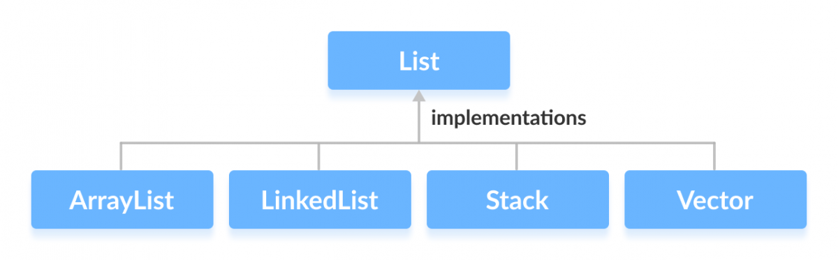
List
In Java, the List interface is an ordered collection that allows us to store and access elements sequentially.
It extends the Collection interface.
In order to use functionalities of the List interface, we can use these classes:
  ArrayList
  LinkedList
  Vector
  Stack
JAVA PROGRAMMING - S.VAISHNAVI

Slide 28
// ArrayList implementation of List
List<String> list1 = new ArrayList<>();
// LinkedList implementation of List
List<String> list2 = new LinkedList<>();
JAVA PROGRAMMING - S.VAISHNAVI

Slide 29
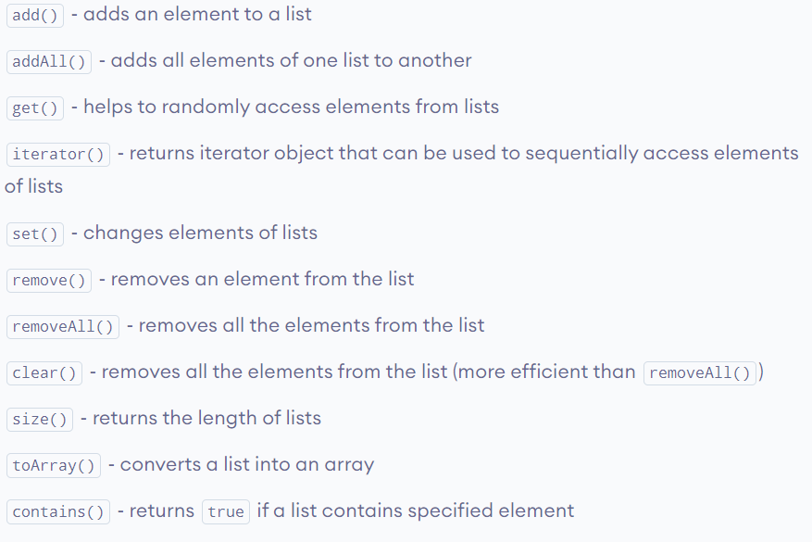
JAVA PROGRAMMING - S.VAISHNAVI

Slide 30
TreeSet
JAVA PROGRAMMING - S.VAISHNAVI

Slide 31
Set
The Set interface of the Java Collections framework provides the features of the mathematical set in Java. It extends the Collection interface.
Unlike the List interface, sets cannot contain duplicate elements.
In order to use functionalities of the Set interface, we can use these classes:
  HashSet
  LinkedHashSet
  EnumSet
  TreeSet
JAVA PROGRAMMING - S.VAISHNAVI

Slide 32
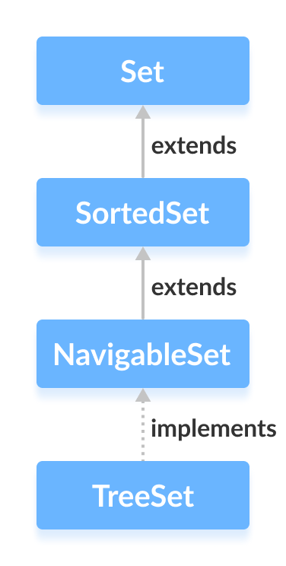
TreeSet
The TreeSet class of the Java collections framework provides the functionality of a tree data structure.
elements in TreeSet are sorted naturally (ascending order)
we can customize the sorting of elements by using
the Comparator interface
TreeSet<Integer> numbers = new TreeSet<>();
JAVA PROGRAMMING - S.VAISHNAVI

Slide 33
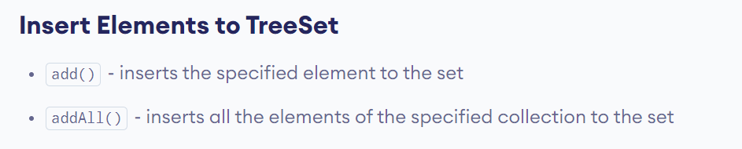
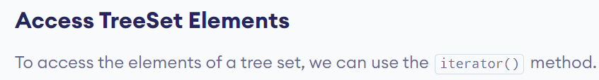
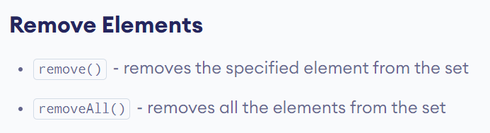
JAVA PROGRAMMING - S.VAISHNAVI

Slide 34
HashMap
JAVA PROGRAMMING - S.VAISHNAVI

Slide 35
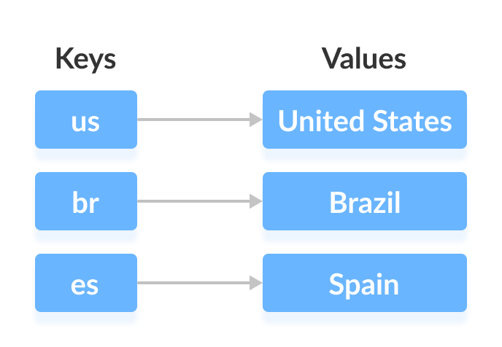
Map
The Map interface of the Java collections framework provides the functionality of the map data structure.
In Java, elements of Map are stored in key/value pairs. Keys are unique values associated with individual Values.
In order to use functionalities of the Map interface, we can use these classes:
  HashMap
  EnumMap
  LinkedHashMap
  WeakHashMap
  TreeMap
JAVA PROGRAMMING - S.VAISHNAVI

Slide 36
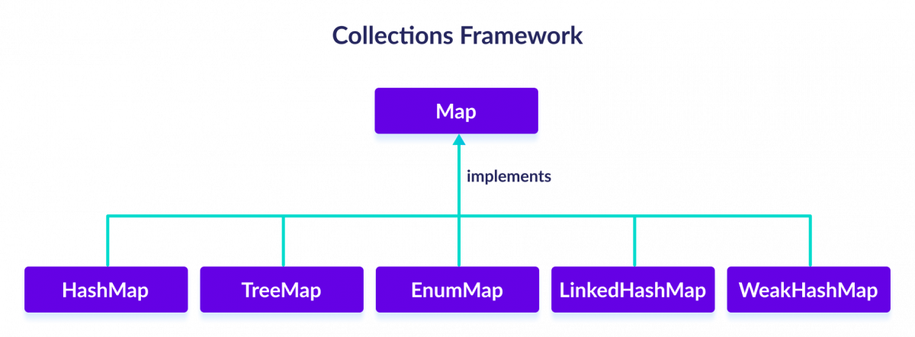
JAVA PROGRAMMING - S.VAISHNAVI

Slide 37
HashMap
The HashMap class of the Java collections framework provides the functionality of the hash table data structure
It stores elements in key/value pairs. Here, keys are unique identifiers used to associate each value on a map
HashMap<K, V> numbers = new HashMap<>();
HashMap<String, Integer> numbers = new HashMap<>();
the type of keys is String and the type of values is Integer
JAVA PROGRAMMING - S.VAISHNAVI

Slide 38
Enum
JAVA PROGRAMMING - S.VAISHNAVI

Slide 39
EnumMap
The EnumMap class of the Java collections framework provides a map implementation for elements of an enum.
In EnumMap, enum elements are used as keys. It implements the Map interface.
import the java.util.EnumMap
enum Size {
SMALL, MEDIUM, LARGE, EXTRALARGE
}
EnumMap<Size, Integer> sizes = new EnumMap<>(Size.class);
the type of keys is String and the type of values is Integer
JAVA PROGRAMMING - S.VAISHNAVI

Slide 40
Stack
JAVA PROGRAMMING - S.VAISHNAVI

Slide 41
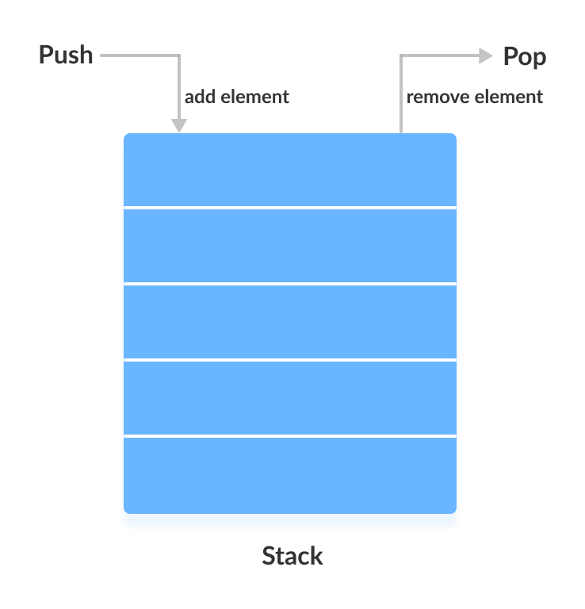
Stack
The Java collections framework has a class named Stack that provides the functionality of the stack data structure.
The Stack class extends the Vector class.
In stack, elements are stored and accessed in Last In First Out manner.
Stack<Type> stacks = new Stack<>();
// Create Integer type stack
Stack<Integer> stacks = new Stack<>();
// Create String type stack
Stack<String> stacks = new Stack<>();
JAVA PROGRAMMING - S.VAISHNAVI

Slide 42
Queue
JAVA PROGRAMMING - S.VAISHNAVI

Slide 43
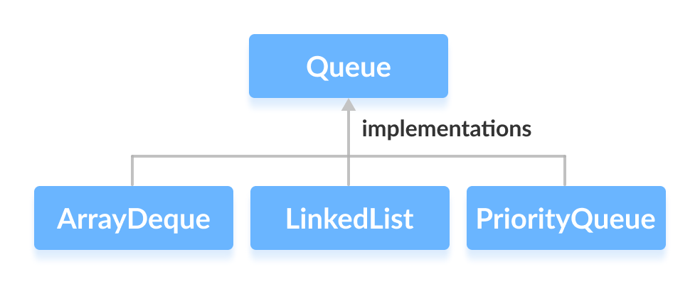
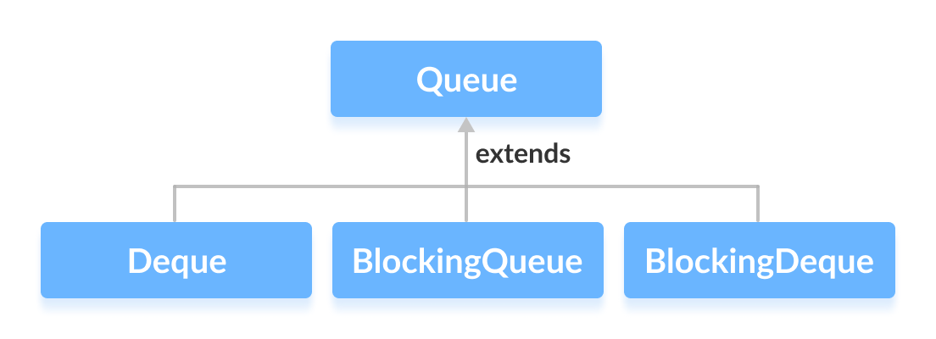
Queue
The Queue interface of the Java collections framework provides the functionality of the queue data structure
JAVA PROGRAMMING - S.VAISHNAVI

Slide 44
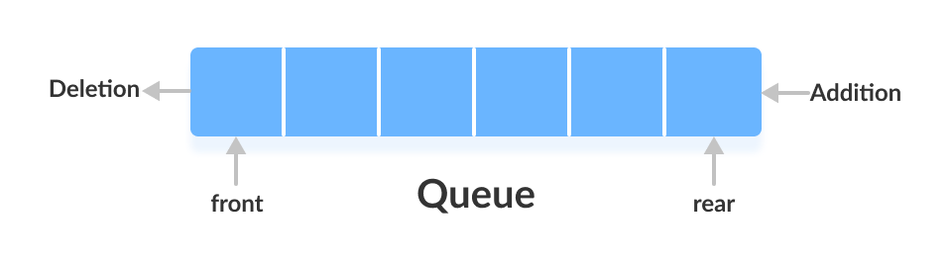
Working of Queue Data Structure
In queues, elements are stored and accessed in First In, First Out manner.
That is, elements are added from the behind and removed from the front.
JAVA PROGRAMMING - S.VAISHNAVI

Slide 45
How to use Queue?
In Java, we must import java.util.Queue package in order to use Queue
// LinkedList implementation of Queue
Queue<String> animal1 = new LinkedList<>();
// Array implementation of Queue
Queue<String> animal2 = new ArrayDeque<>();
// Priority Queue implementation of Queue
Queue<String> animal 3 = new PriorityQueue<>();
JAVA PROGRAMMING - S.VAISHNAVI

Slide 46
Deque
JAVA PROGRAMMING - S.VAISHNAVI

Slide 47
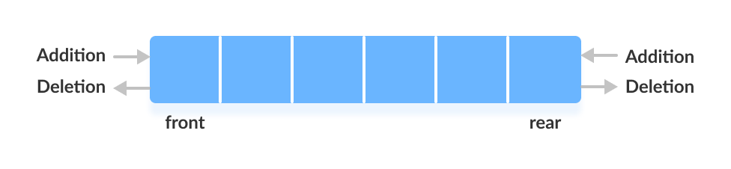
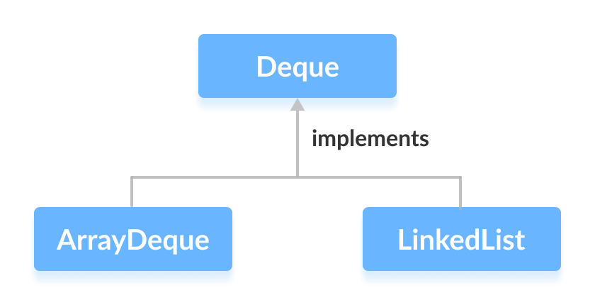
Deque
The Deque interface of the Java collections framework provides the functionality of a double-ended queue. It extends the Queue interface
in a deque, we can insert and remove elements from both front and rear.
JAVA PROGRAMMING - S.VAISHNAVI

Slide 48
How to use Deque?
In Java, we must import the java.util.Deque package to use Deque
// Array implementation of Deque
Deque<String> animal1 = new ArrayDeque<>();
// LinkedList implementation of Deque
Deque<String> animal2 = new LinkedList<>();
JAVA PROGRAMMING - S.VAISHNAVI

Slide 49
Lambda Expressions - Functional Interfaces
JAVA PROGRAMMING - S.VAISHNAVI

Slide 50
Functional Interface
If a Java interface contains one and only one abstract method then it is termed as functional interface.
This only one method specifies the intended purpose of the interface.
Since we know that a functional interface has just one method, there should be no need to define the name of that method when passing it as an argument. Lambda expression allows us to do exactly that.
import java.lang.FunctionalInterface;
@FunctionalInterface
public interface MyInterface{
// the single abstract method
double getValue();
}
JAVA PROGRAMMING - S.VAISHNAVI

Slide 51
lambda expressions
an anonymous or unnamed method
does not execute on its own. Instead, it is used to implement a method defined by a functional interface
Syntax
-> is know as arrow operator or a lambda operator
double getPiValue()
{
return 3.1415;
}
(parameter list) -> lambda body
() -> 3.1415
JAVA PROGRAMMING - S.VAISHNAVI

Slide 52
Types of Lambda Body
A body with a single expression
2. A body that consists of a block of code.
() -> System.out.println("Lambdas are great");
() -> {
double pi = 3.1415;
return pi;
};
JAVA PROGRAMMING - S.VAISHNAVI

Slide 53
Method References
JAVA PROGRAMMING - S.VAISHNAVI

Slide 54
Method References
Java provides a new feature called method reference in Java 8.
Method reference is used to refer method of functional interface.
It is compact and easy form of lambda expression.
Each time when you are using lambda expression to just referring a method, you can replace your lambda expression with method reference
ContainingClass::staticMethodName
JAVA PROGRAMMING - S.VAISHNAVI

Slide 55
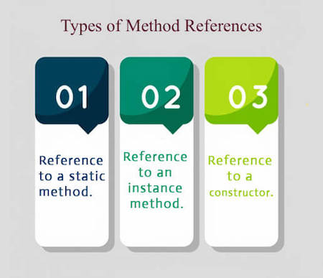
JAVA PROGRAMMING - S.VAISHNAVI

Slide 56

JAVA PROGRAMMING - S.VAISHNAVI

